Slide 1
Seller Transparency

Slide 2
Relationship between Seller Age and Sales
aoeui

Slide 3
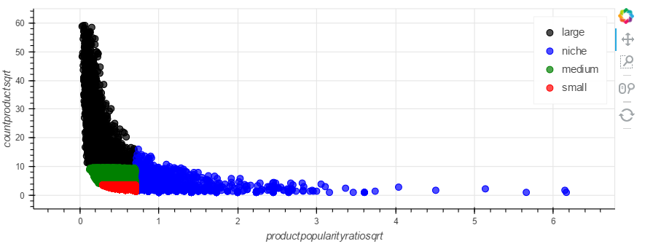
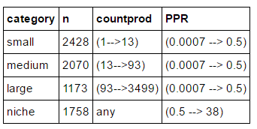
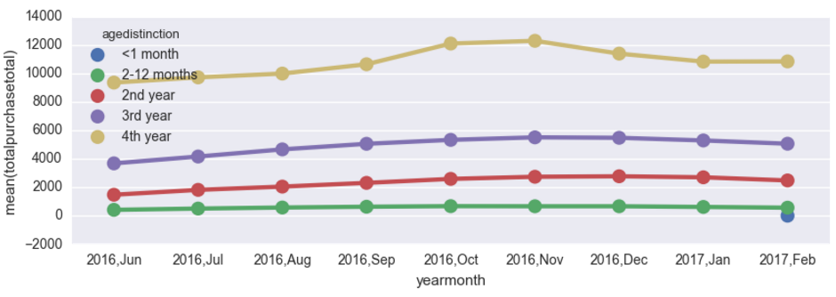
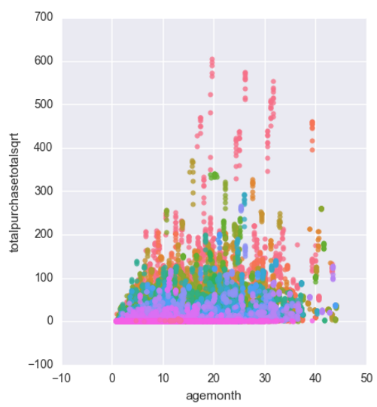
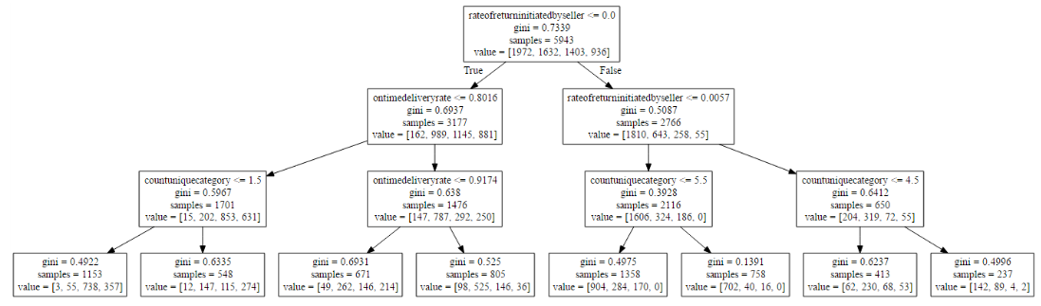
Relationship between Seller Size and Sales
We use size of sellers as a badge criteria to reward to sellers. Those sellers which perform well through the metrics of product popularity ratio (average purchase of the products/count of distinct products). Will be known as niche
Age matters to determine the total purchase of sellers. The older the seller is, the higher is the total purchase. However, this is not reflected for all categories
Seller with early to on time deliveries are more likely to receive higher total purchases. Further analysis shown that most of these sellers are dropshipping their goods and these analysis are more likely to be found in the local rather than international sellers

Slide 4
Relationship between Seller Delivery and Sales
aoeui

Slide 5
Difference between Price of Assortment and Sales
aoeui

Slide 6
Analysis on Seller Return Rate
aoeui

Slide 7
Analysis on Seller-initiated Cancellation Rate
aoeui

